Slide 1

Literature Review & Project Context: Arsenic Skin Detection Using Machine Learning
CSE 499A: Project Work | Section: 15
Group: 07 | Amit Chandra Das (2014242042), Tanushree Das (2212225042), Ashraful Islam (2212669042)

Slide 2
Introduction
Our Project Goal: To develop a machine learning model using Convolutional Neural Networks (CNNs) to accurately classify skin images as either affected or unaffected by arsenic poisoning.
Literature Review Purpose: To understand the existing work – specifically the available dataset, common methods, and the best current results (the benchmark) – to guide and position our project.

Slide 3
Paper 1 - Establishing the Dataset
Paper: Khan, A.H., et al. "ArsenicSkinImageBD: A Novel Dataset..." (Processes, 2023).
Their Contribution: Created and shared the first public dataset of 8892 arsenic vs. non-arsenic skin images from Bangladesh (ArsenicSkinImageBD).
Relevance to Our Project: We are using this exact dataset
This ensures our work is directly comparable to others using this data.
Our notebook confirms the dataset is balanced (4446 images per class).

Slide 4
Paper 2 - Setting the Benchmark: ArsenicNet
Paper: Khan, A.H., et al. "A Hybrid DCNN Model..." (Diagnostics, 2024).
Their Contribution: Developed "ArsenicNet," a complex hybrid model (Xception + InceptionV3), specifically for the ArsenicSkinImageBD dataset.
Their Result: Achieved a high accuracy of 97.69%.
Relevance to Our Project: This is the target performance we aim to compare our models against
It shows that high accuracy is possible on this dataset with advanced CNNs.

Slide 5
Paper 3 - Validating the General Approach
Paper: Al-Masni, M.A., et al. "A Survey on Machine Learning Methods in Skin Disease Recognition." (Diagnostics, 2020).
Their Contribution: Reviewed many papers on skin disease image analysis.
Their Finding: Confirmed that CNNs (like VGG, ResNet, Inception) are the standard and most successful method for this type of image classification task.
Relevance to Our Project:This review justifies our choice to use CNN-based architectures.
Our baseline CNN and our planned ResNet50 model are appropriate methods according to this survey.

Slide 6
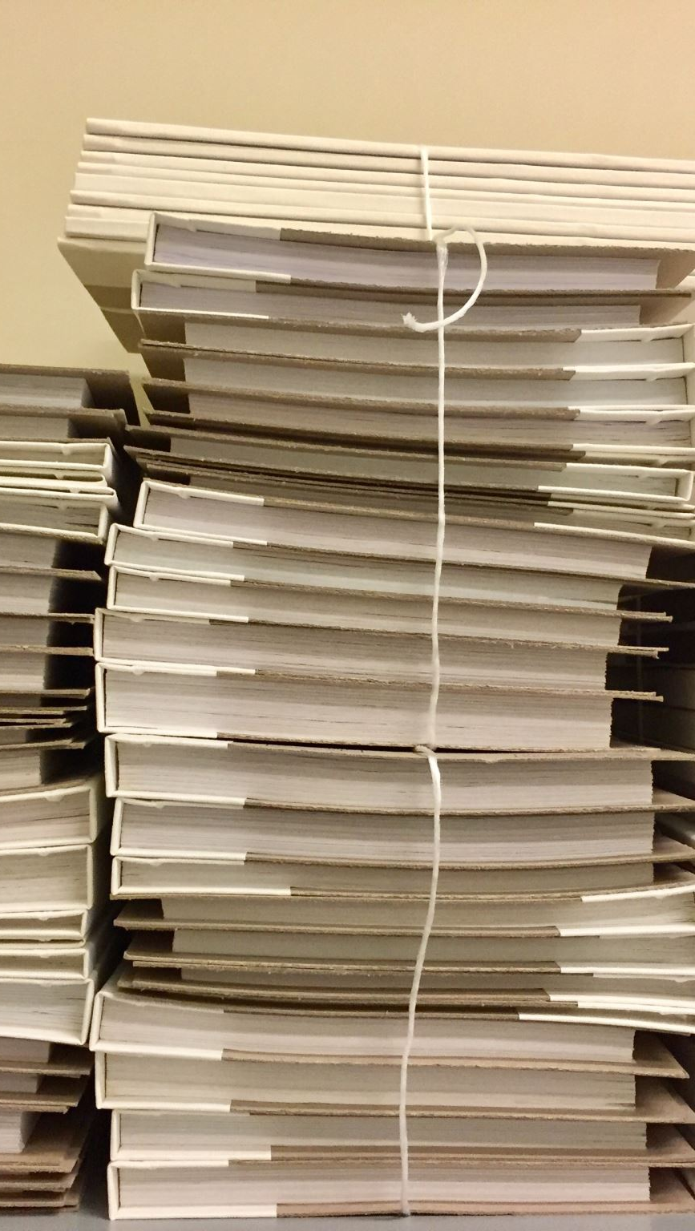
Synthesizing the Literature
What We Know:
The ArsenicSkinImageBD dataset is the standard for this problem (Paper 1).
CNNs are the best tool for the job (Paper 3).
A hybrid (Xception+InceptionV3) model achieved 97.69% accuracy (Paper 2).

Slide 7
Defining Our Project's Focus
Our project explores a different approach:
Baseline: We've built a standard CNN to establish a basic performance level on this data.
Advanced Model: We are implementing ResNet50 (another powerful and widely used CNN architecture, possibly enhanced with SimCLR (to see if it can match or beat the ArsenicNet benchmark using a different design.
Goal: Compare the performance of our baseline CNN and ResNet50 against the 97.69% benchmark on the same dataset.

Slide 8

Our project current status
Data Acquired & Prepared:
Downloaded and extracted the 8892-image ArsenicSkinImageBD dataset.
Confirmed dataset is balanced (4446 infected / 4446 not infected).
Loaded all filenames and created corresponding numerical labels (1/0).
Visually verified sample images from each class.
Libraries Imported: All necessary libraries (OS, NumPy, Matplotlib, PIL, Sklearn) are ready.
Initial Workflow Defined: Code structure for preprocessing, splitting, and model building is in place

Slide 9
Next Steps
Run Preprocessing: Execute image resizing (128x128), RGB conversion, and NumPy array transformation.
Split & Scale Data: Perform Train/Test split (80/20) and scale pixel values to [0, 1].
Train & Evaluate Baseline CNN:
Build, compile, and train the defined CNN model.
Evaluate its accuracy on the test set and visualize performance.
Implement & Test ResNet50/ SimCLR:
Debug and run the advanced model implementation.
Evaluate its accuracy.
Compare & Conclude: Compare model results against the 97.69% benchmark from literature.
End slides

